Slide 1
Collections (http://docs.oracle.com/javase/tutorial/collections/ index.html)
Notes:
Lists are common data in almost all of programs. In this lesson, the framework for managing group of elements in the java.util package are introduced . If you use them, you will save noticeable efforts.

Slide 2
Objectives
Collections Framework (package java.util):
List: ArrayList, Vector → Duplicates are agreed
Set: HashSet, TreeSet → Duplicates are not agreed
Map: HashMap, TreeMap

Slide 3
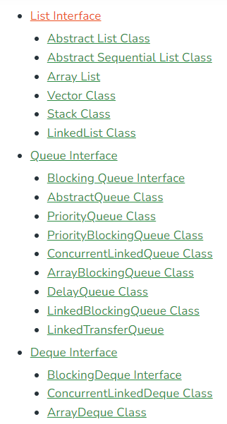
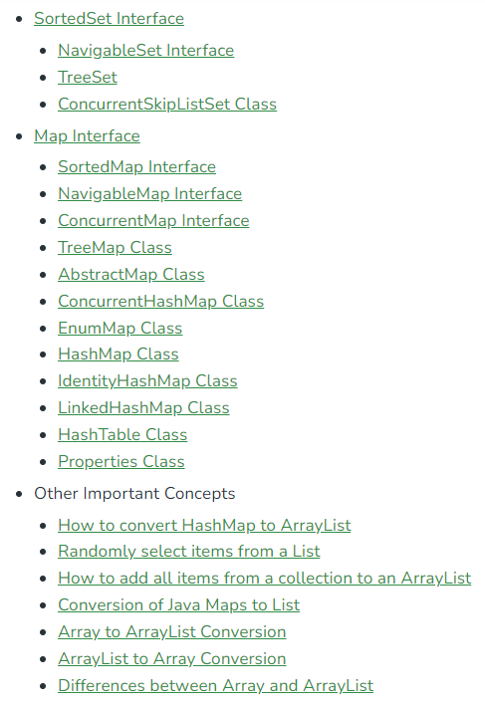
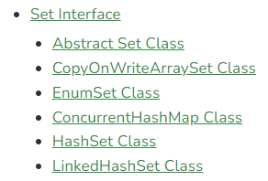
Collections in Java

Slide 4
The Collections Framework
The Java 2 platform includes a new collections framework.
A collection is an object that represents a group of objects.
The Collections Framework is a unified architecture for representing and manipulating collections.
The collections framework as a whole is not threadsafe.
Notes:
Thread: unit of running code (methods) of a process ( program in running).
Nowaday, operating systems support the time-sharing mechanism which allows many process running concurrently. CPU will run instructions of each process in a duration (about 50 milsecond) the the process will pause to yield CPU to others.
Also, a computer can have a multicore-CPU with 2, 4, 8,… cores. Some processes/ threads execute really concurrently.
A common data can be accessed by some threads concurrently → It’s value is not reliable → not threadsafe.
To make a common data being reliable, a mechanism in which at a time, only one thread is granted to access this data → Synchronization → threadsafe

Slide 5
The Collections Framework…
Reduces programming effort by providing useful data structures and algorithms so you don't have to write them yourself.
Increases performance by providing high-performance implementations of useful data structures and algorithms.
Provides interoperability between unrelated APIs by establishing a common language to pass collections back and forth.
Reduces the effort required to learn APIs by eliminating the need to learn multiple ad hoc collection APIs.
Reduces the effort required to design and implement APIs by eliminating the need to produce ad hoc collections APIs.
Fosters software reuse by providing a standard interface for collections and algorithms to manipulate them.

Slide 6
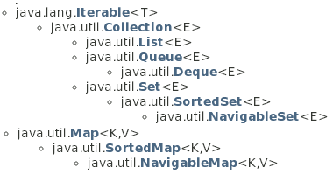
Collection Interfaces
Methods declared in these interfaces can work on a list containing elements which belong to arbitrary type. T: type, E: Element, K: Key, V: Value
Details of this will be introduced in the topic Generic
3 types of group:
List can contain duplicate elements
Set can contain distinct elements only
Map can contain pairs <key, value>. Key of element is data for fast searching
Queue, Deque contains methods of restricted list.
Common methods on group are: Add, Remove, Search, Clear,…

Slide 7
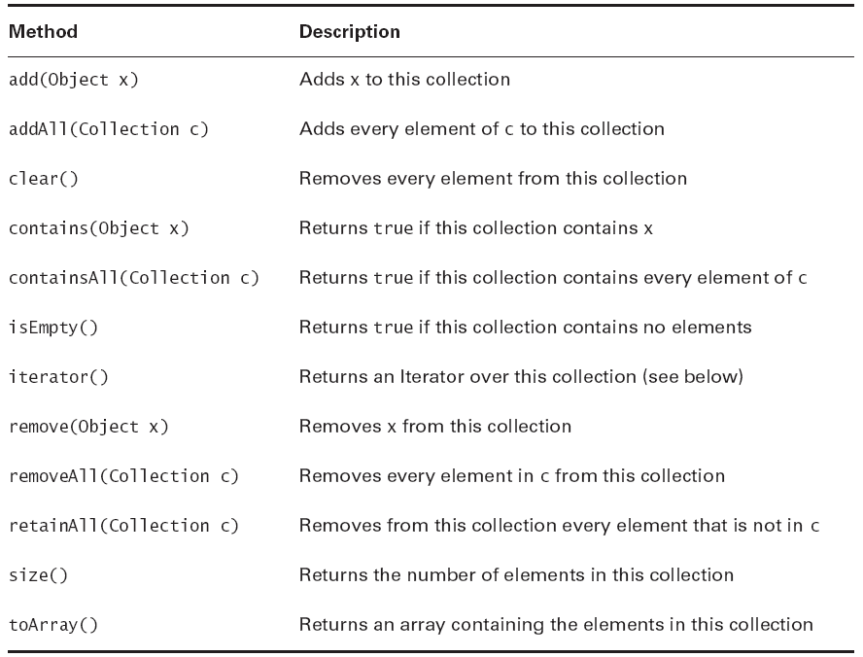
Common Methods of the interface Collection
Elements can be stored using some ways such as an array, a tree, a hash table.
Sometimes, we want to traverse elements as a list → We need a list of references → Iterator

Slide 8
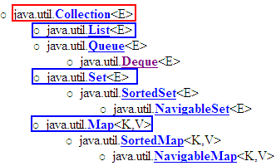



The Collection Framework…
Central Interfaces
Common Used Classes
Store: Dynamic array
Use index to access an element.
Store: Specific structure/tree
Use iterator to access elements
java.lang.Comparable interface
keySet()
values()
Use iterator
A TreeSet will stored elements using ascending order. Natural ordering is applied to numbers and lexicographic (dictionary) ordering is applied to strings.
If you want a TreeSet containing your own objects, you must implement the method compareTo(Object), declared in the Comparable interface.

Slide 9
Classes Implementing the interface List
AbstractList
ArrayList
Vector (like ArrayList but it is synchronized)
LinkedList: linked lists can be used as a stack, queue, or double-ended queue (deque)

Slide 10
Lists
A List keeps it elements in the order in which they were added.
Each element of a List has an index, starting from 0.
Common methods:
void add(int index, Object x)
Object get(int index)
int indexOf(Object x)
Object remove(int index)

Slide 11
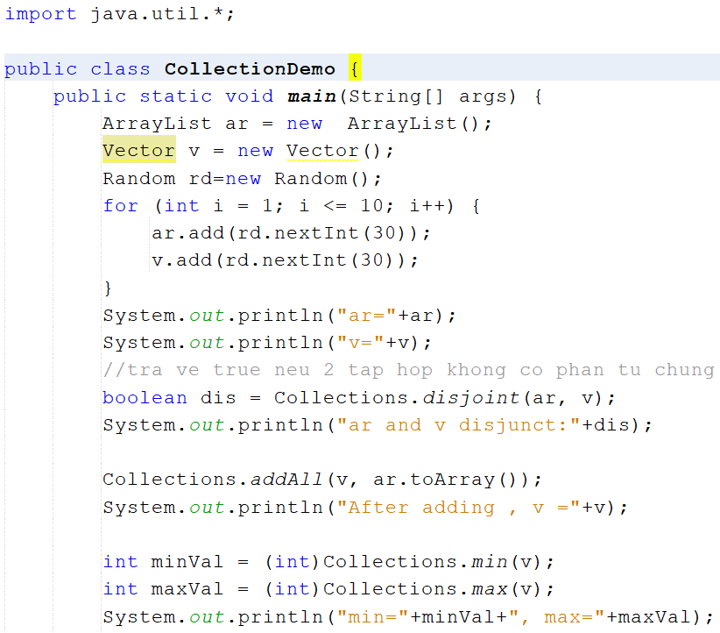
Collection Demo

Slide 12
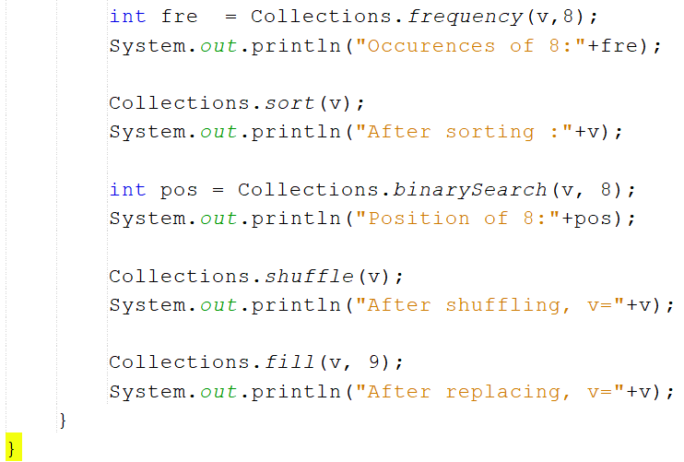
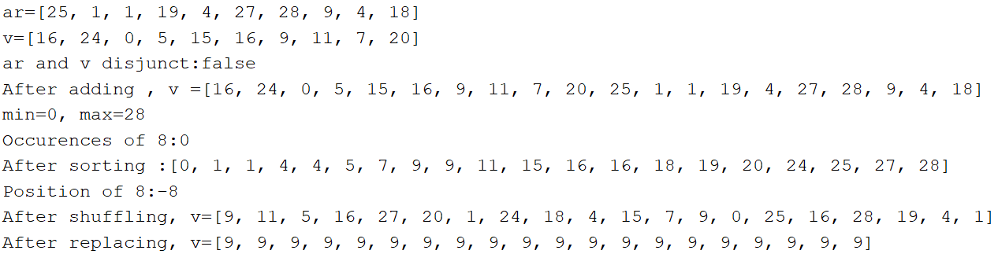

Slide 13
List Implementing Classes
ArrayList list= new ArrayList();
for (int i = 101; i <= 110; i++) {
list.add(i);
}
for (int i = 0; i < list.size(); i++) {
System.out.println(list.get(i));
}
//or using Iterator
/*
Iterator iter = list.iterator();
while (iter.hasNext()) {
System.out.println(iter.next());
}
*/

Slide 14
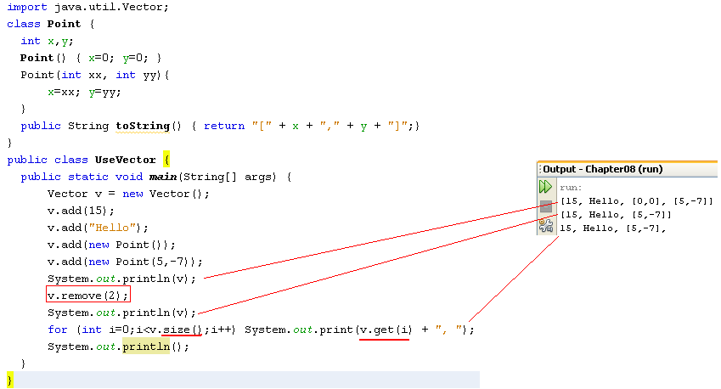
Using the Vector class
java.util.Vector<E> (implements java.lang.Cloneable,
java.util.List<E>, java.util.RandomAccess, java.io.Serializable)
The Vector class is obsolete from Java 1.6 but it is still introduced because it is a parameter in the constructor of the javax.swing.JTable class, a class will be introduced in GUI programming.

Slide 15
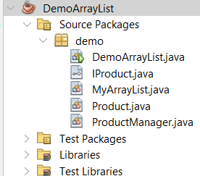
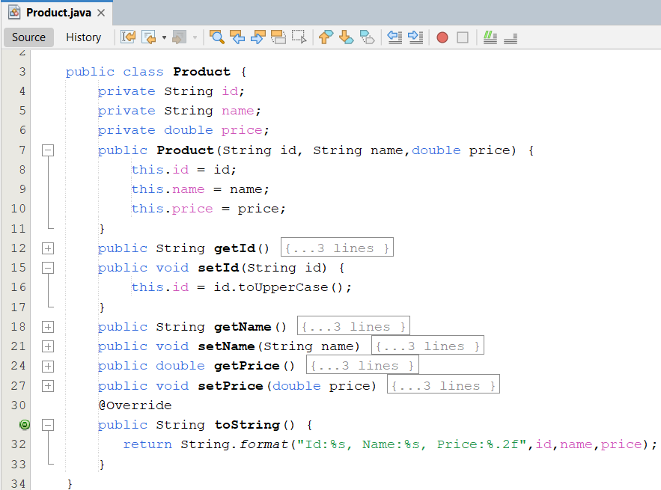
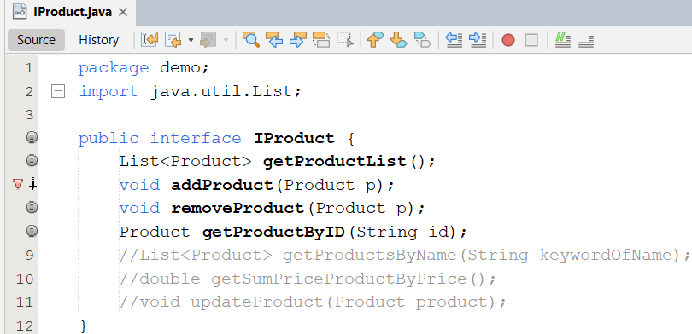
Demo ArrayList
Create the project as follows:
1
2

Slide 16
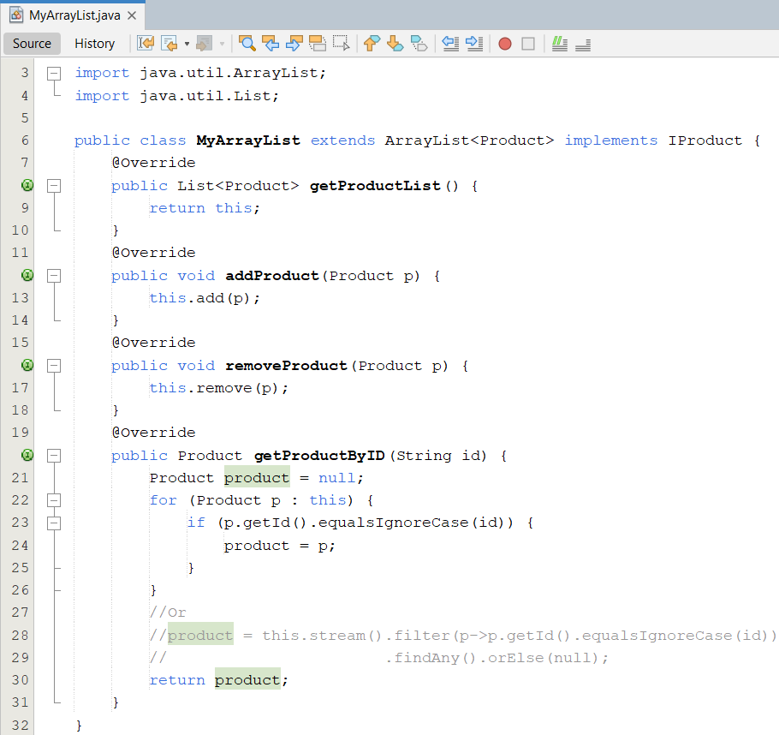
3

Slide 17
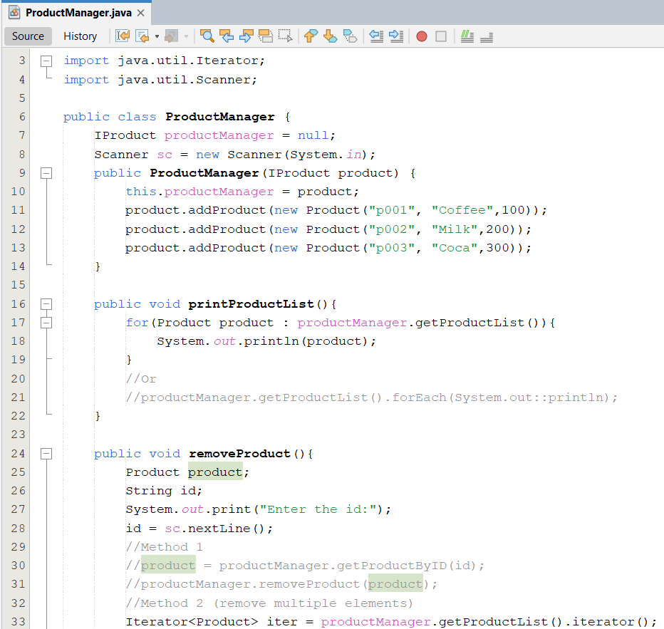
4

Slide 18
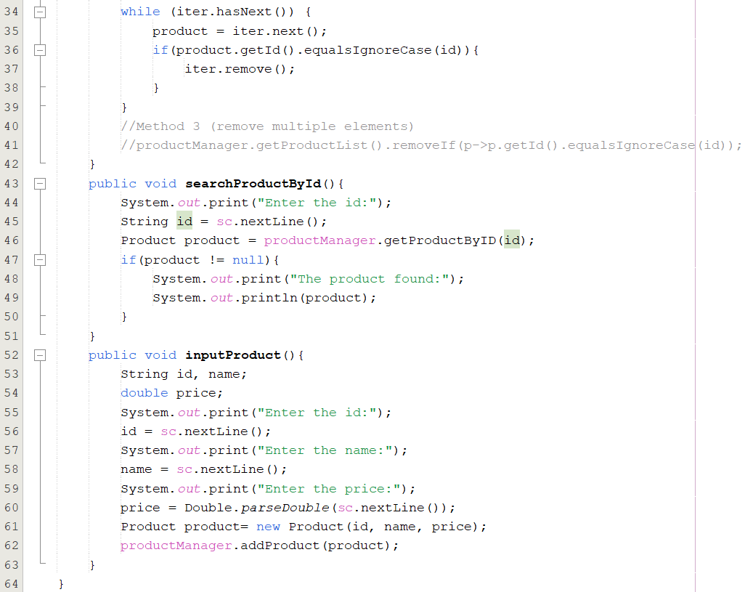

Slide 19
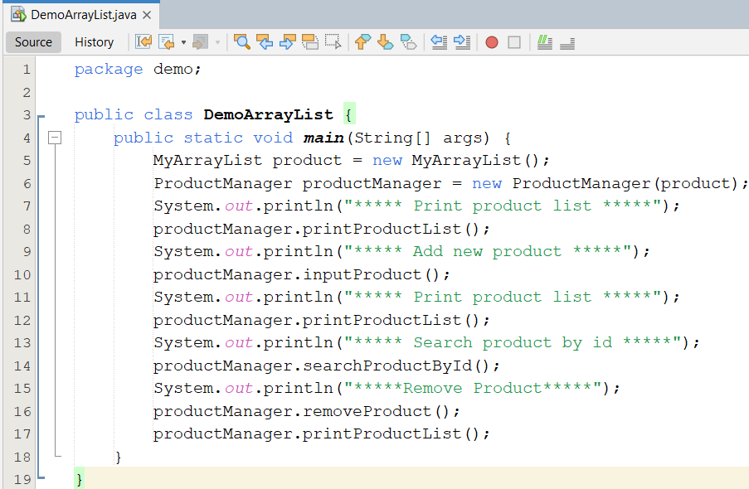
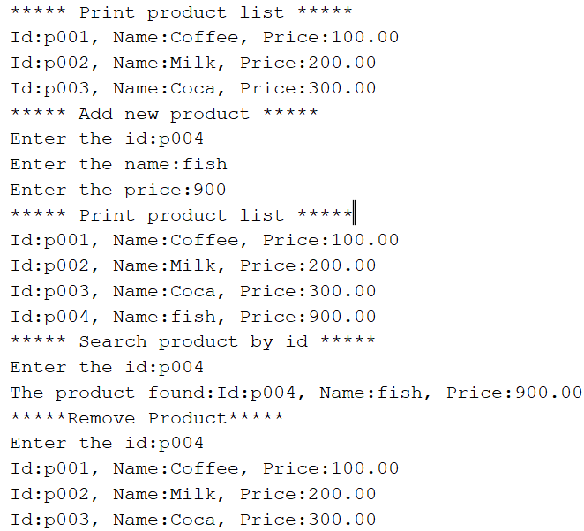
5

Slide 20
Sets
Lists are based on an ordering of their members. Sets have no concept of order.
A Set is just a cluster of references to objects.
Sets may not contain duplicate elements.
Sets use the equals() method, not the == operator, to check for duplication of elements.
void addTwice(Set set) {
set.clear();
Point p1 = new Point(10, 20);
Point p2 = new Point(10, 20);
set.add(p1);
set.add(p2);
System.out.println(set.size());
}
will print out 1, not 2.

Slide 21
Sets…
Set extends Collection but does not add any additional methods.
The two most commonly used implementing classes are:
TreeSet
Guarantees that the sorted set will be in ascending element order.
log(n) time cost for the basic operations (add, remove and contains).
HashSet
Constant time performance for the basic operations (add, remove, contains and size).

Slide 22
TreeSet and Iterator
Ordered Tree – Introduced in the subject Discrete Mathematics
Set: Group of different elements
TreeSet: Set + ordered tree, each element is called as node
Iterator: An operation in which references of all node are grouped to make a linked list. Iterator is a way to access every node of a tree.
Linked list: a group of elements, each element contains a reference to the next

Slide 23
TreeSet = Set + Tree
The result may be:
Random r = new Random();
TreeSet myset = new TreeSet();
for (int i = 0; i < 10; i++) {
int number = r.nextInt(100);
myset.add(number);
}
//using Iterator
Iterator iter = myset.iterator();
while (iter.hasNext()) {
System.out.println(iter.next());
}
7
27
36
41
43
46
49
57
75
83

Slide 24
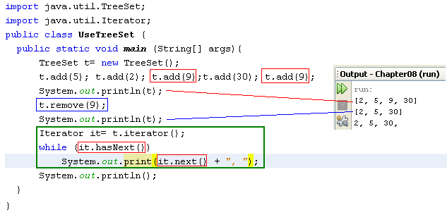
Using the TreeSet class & Iterator
A TreeSet will stored elements using ascending order. Natural ordering is applied to numbers and lexicographic (dictionary) ordering is applied to strings.
If you want a TreeSet containing your own objects, you must implement the method compareTo(Object), declared in the Comparable interface.

Slide 25
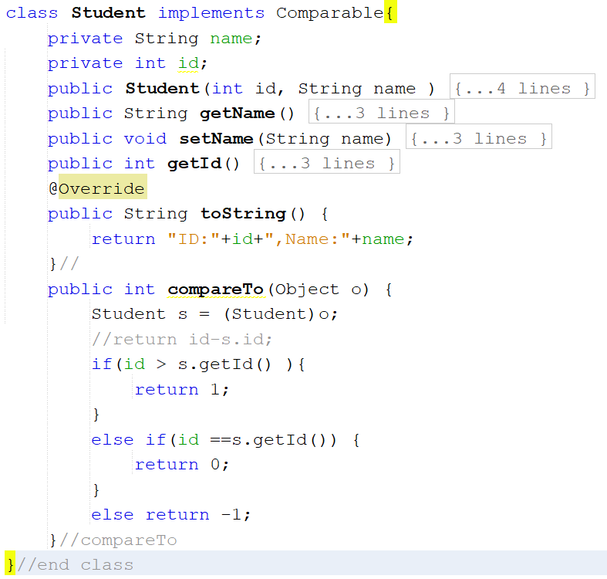
TreeSet Demo-01

Slide 26
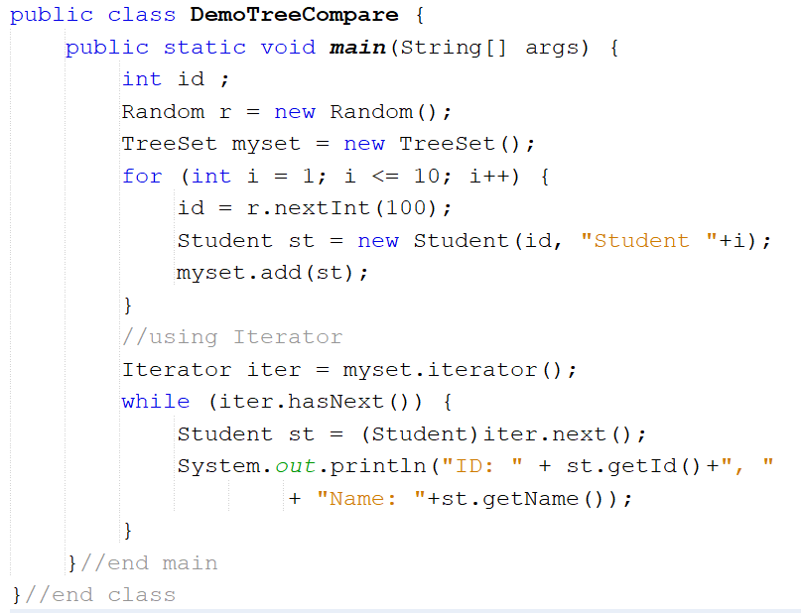
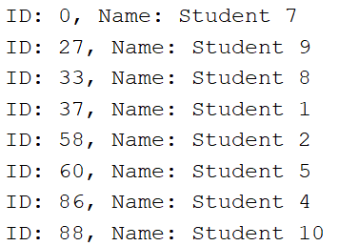

Slide 27
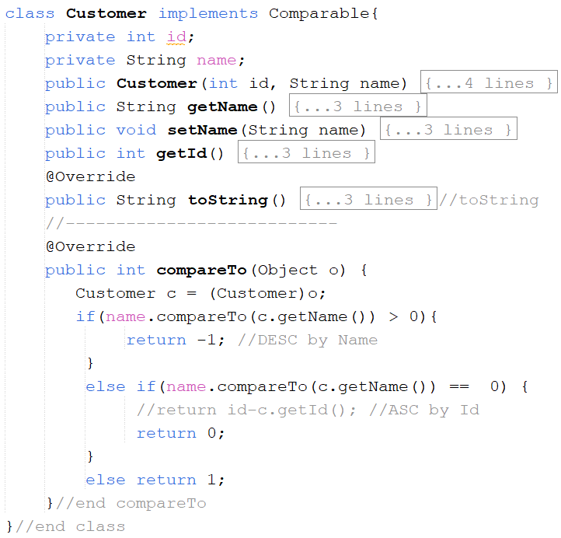
TreeSet Demo-02
Create DemoTreeSetWithObject.java as follows:

Slide 28
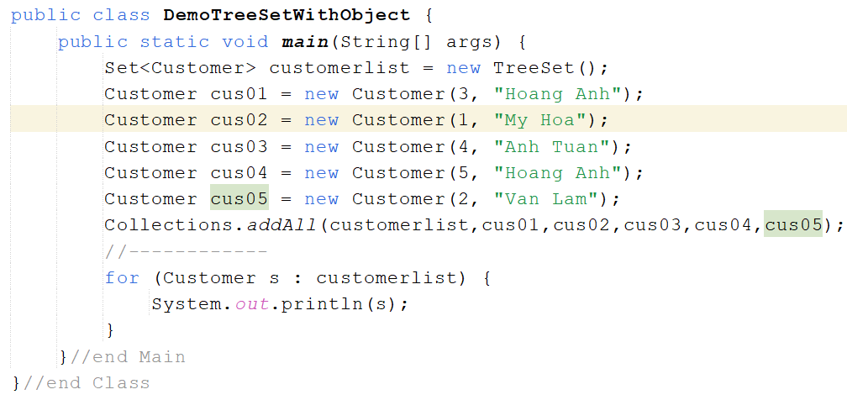
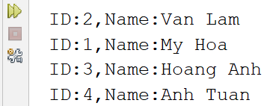
TreeSet Demo-02
Notes:
-Compare To : return 0 thì in ra customer đầu tiên : 3 – Hoàng Anh
-Compare To : return -1 / 1 thì in ra tất cả
*** Integer.compare(n1, n2) : nếu n1 > n2 : return 1, = return 0, n1 < n2: return -1

Slide 29
Hash Table
49
In array, elements are stored in a contiguous memory blocks → Linear search is applied → slow, binary search is an improvement.
Hash table: elements can be stored in a different memory blocks. The index of an element is determined by a function (hash function) → Add/Search operation is very fast (O(1)).
14
Brown
9
Hoa
5
Smith
“Smith”
f
5
The hash function f may be: ‘S’*10000+’m’*1000+’i’*100+’t’*10+’h’ % 50
0
Linel
Notes:
This slide is intended to introduce the most basic concept about a hash table. More details about hash table will be studied in the subject Data Structure and Algorithms.

Slide 30
HashSet = Set + Hash Table
The result may be:
Random r = new Random();
HashSet myset = new HashSet();
for (int i = 0; i < 10; i++) {
int number = r.nextInt(100);
myset.add(number);
}
//using Iterator
Iterator iter = myset.iterator();
while (iter.hasNext()) {
System.out.println(iter.next());
}
84
55
7
76
77
95
94
12
91
44

Slide 31
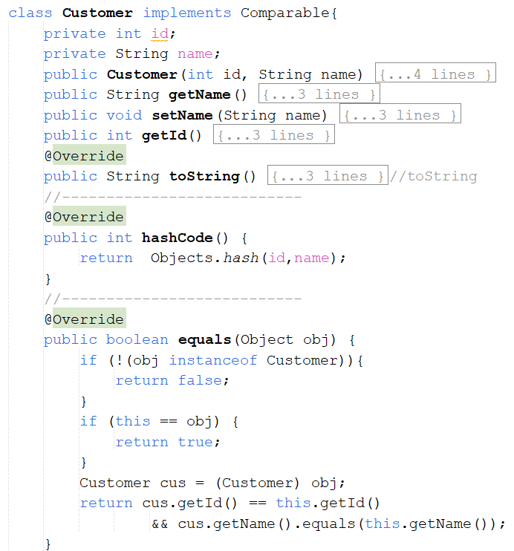
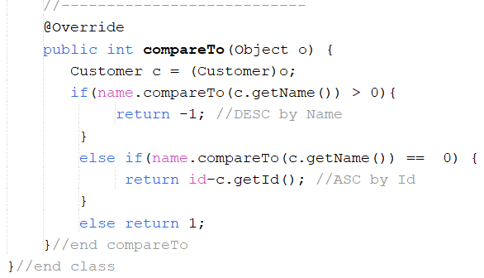
HashSet Demo

Slide 32
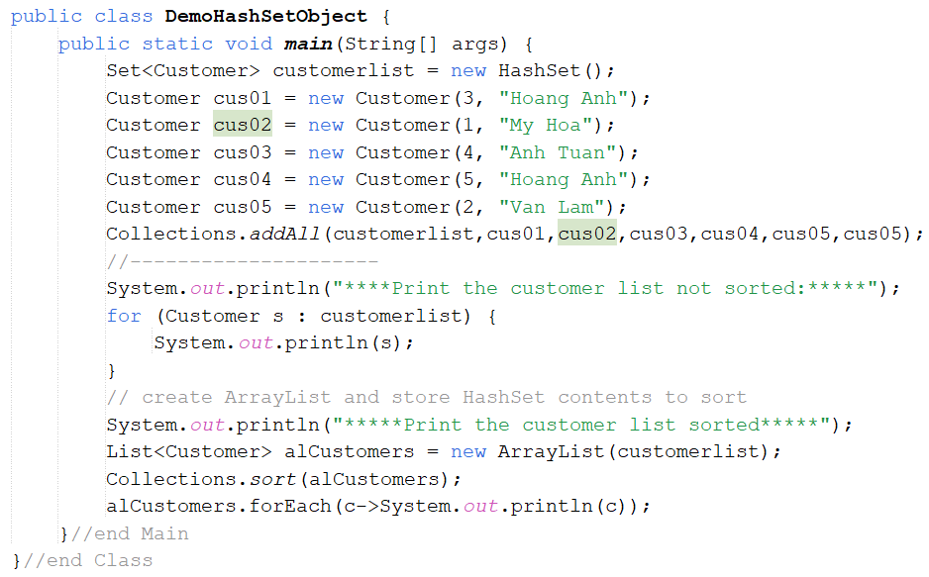
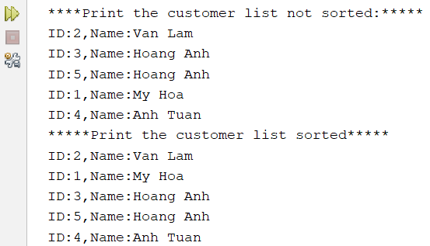
HashSet Demo

Slide 33
HashSet or TreeSet?
If you care about iteration order, use a Tree Set and pay the time penalty.
If iteration order doesn’t matter, use the higher-performance Hash Set.

Slide 34
How to TreeSet ordering elements?
Tree Sets rely on all their elements implementing the interface java.lang.Comparable.
public int compareTo(Object x)
Returns a positive number if the current object is “greater than” x, by whatever definition of “greater than” the class itself wants to use.

Slide 35
How to TreeSet ordering elements?
class Student implements Comparable{
int no;
String name
//constructors…
public int compareTo(Object o) {
Student st = (Student) o;
if(no > st.getNo())
return 1;
else if(no == st.getNo())
return 0;
else
return -1;
}
. . .
}
Comparing 2 students based on their IDs ( field no)

Slide 36
How to TreeSet ordering elements?
public static void main(String[] args) {
Random r = new Random();
TreeSet myset = new TreeSet();
for (int i = 0; i < 10; i++) {
int no = r.nextInt(100);
Student st = new Student(no, "abc");
myset.add(st);
}
//using Iterator
Iterator iter = myset.iterator();
while (iter.hasNext()) {
Student st = (Student)iter.next();
System.out.println("No: " + st.getNo());
}
}
No: 2
No: 8
No: 11
No: 19
No: 33
No: 52
No: 78
No: 83
No: 92
No: 96

Slide 37
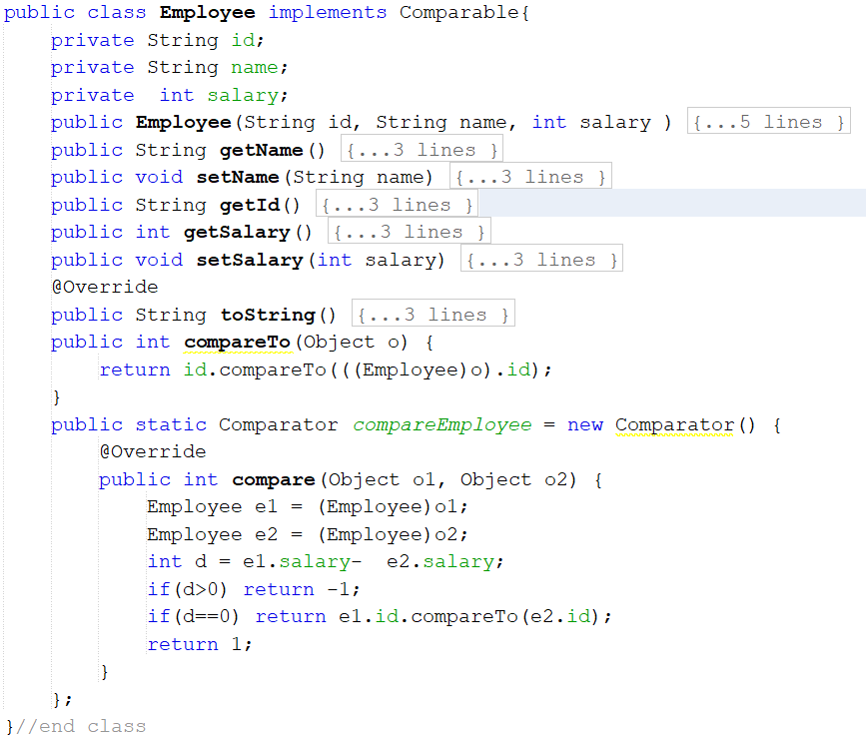
Sorting with Comparator Demo

Slide 38
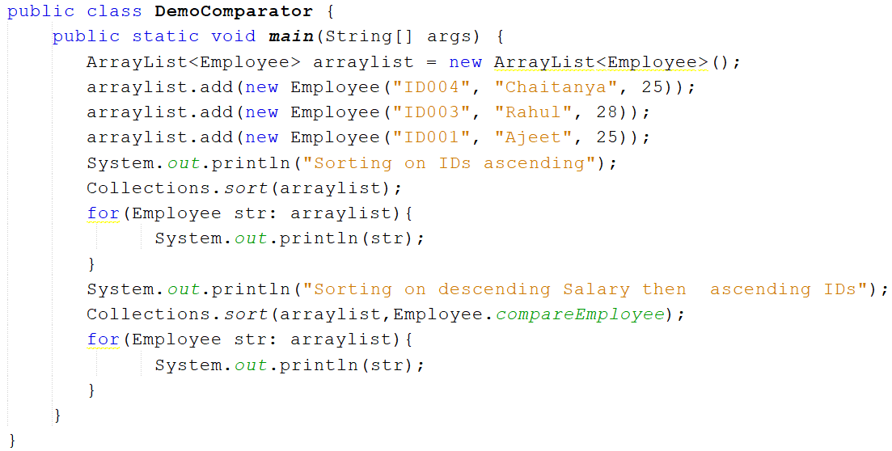
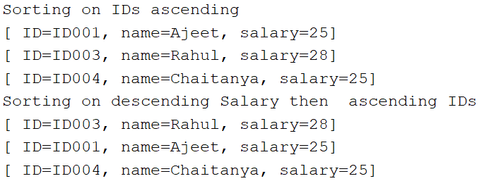

Slide 39
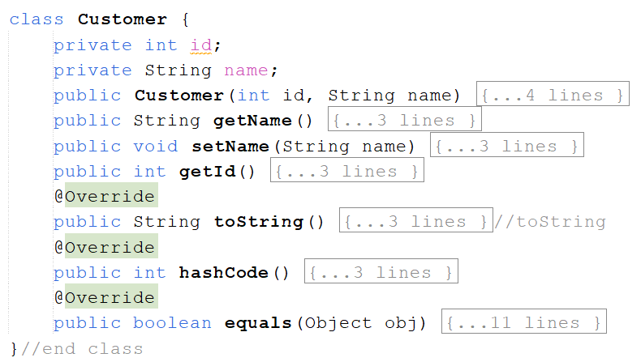
Sorting with Lambda Expressions

Slide 40
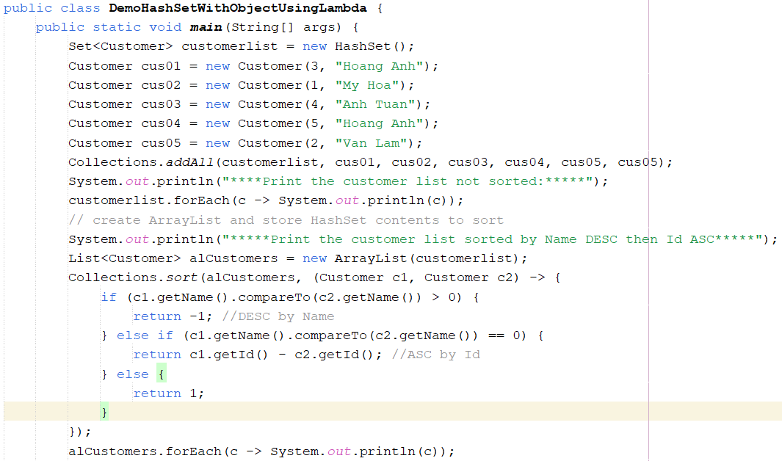
Sorting with Lambda Expressions

Slide 41
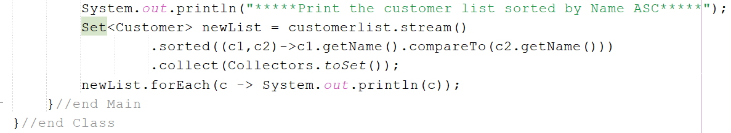
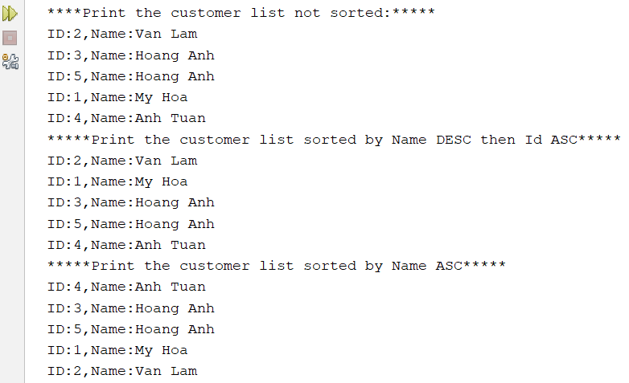
Sorting with Lambda Expressions

Slide 42
Maps
Map doesn’t implement the java.util.Collection interface.
A Map combines two collections, called keys and values.
The Map’s job is to associate exactly one value with each key.
A Map like a dictionary.
Maps check for key uniqueness based on the equals() method, not the == operator.
IDs, Item code, roll numbers are keys.
The normal data type for keys is String.
K
V
key
value
Each element: <key,value>

Slide 43
Maps..
Java’s two most important Map classes:
HashMap (mapping keys are unpredictable order – hash table is used, hash function is pre-defined in the Java Library).
TreeMap (mapping keys are natural order)-> all keys must implement Comparable (a tree is used to store elements).

Slide 44
HashMap
public static void main(String[] args) {
HashMap mymap = new HashMap();
mymap.put(1, “One");
mymap.put(2, “Two");
mymap.put(3, “Three");
mymap.put(4, “Four");
//using Iterator
Iterator iter = mymap.keySet().iterator();
while (iter.hasNext()) {
Object key = iter.next();
System.out.println(key + ": " + mymap.get(key));
}
}
//output
1: One
2: Two
3: Three
4: Four
Key: integer, value: String

Slide 45
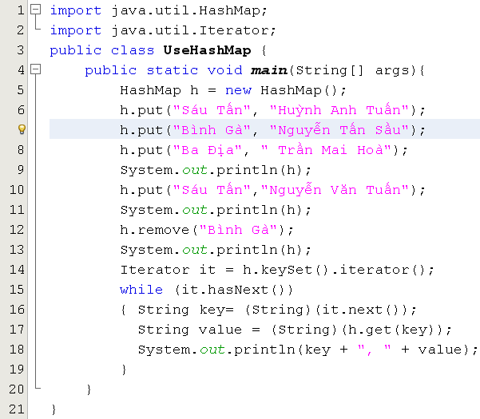
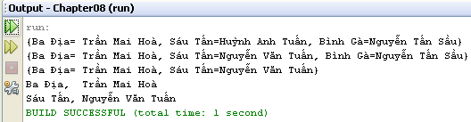
Using HashMap class & Iterator
Key: String, value: String

Slide 46
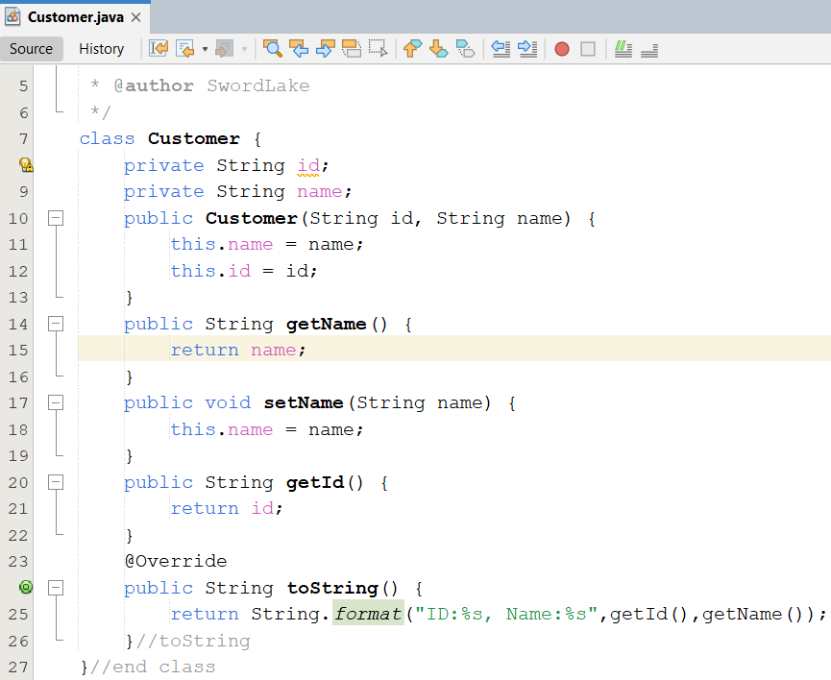
Demo HashMap 01

Slide 47
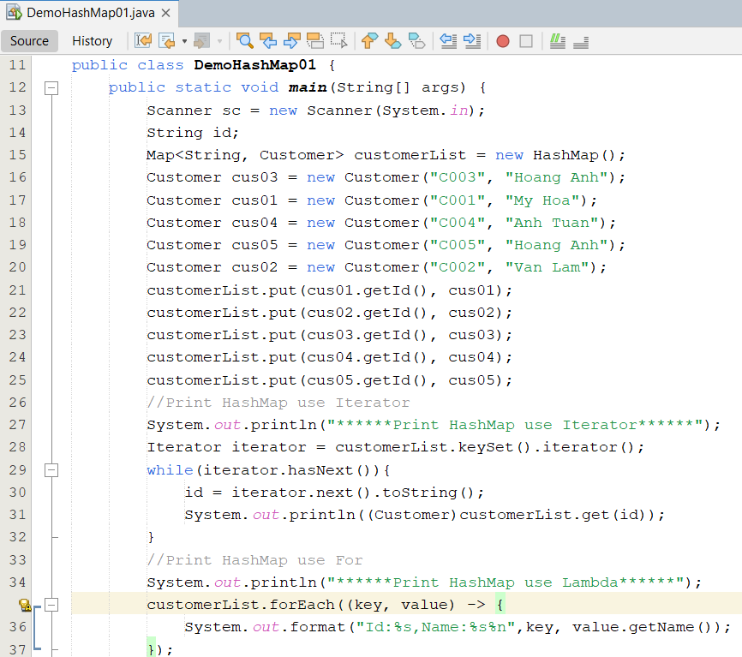
Demo HashMap 01

Slide 48
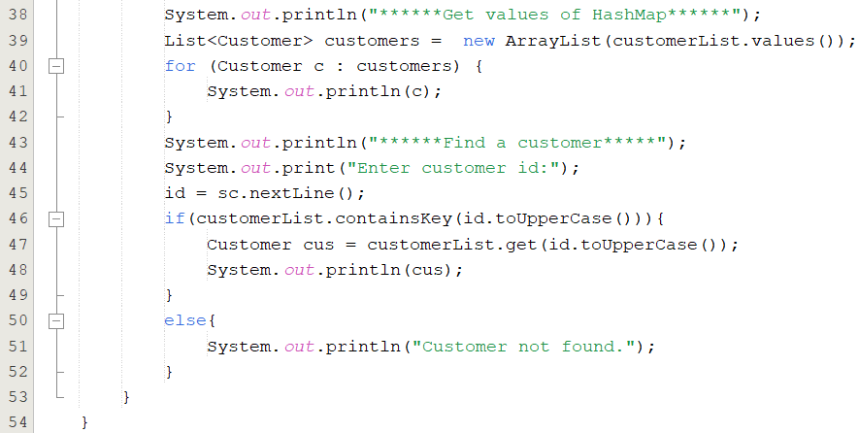
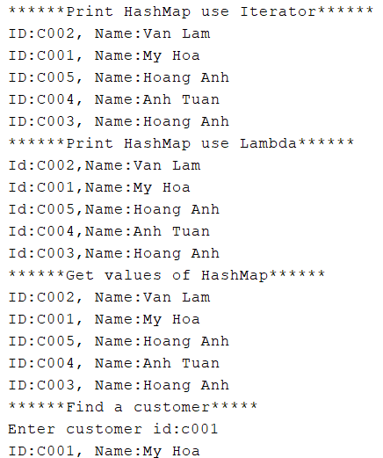
Demo HashMap 01

Slide 49
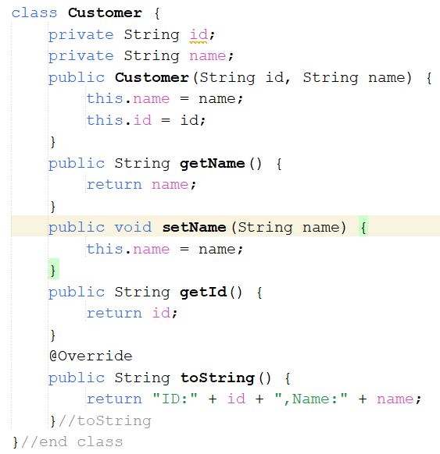
Demo HashMap 02

Slide 50
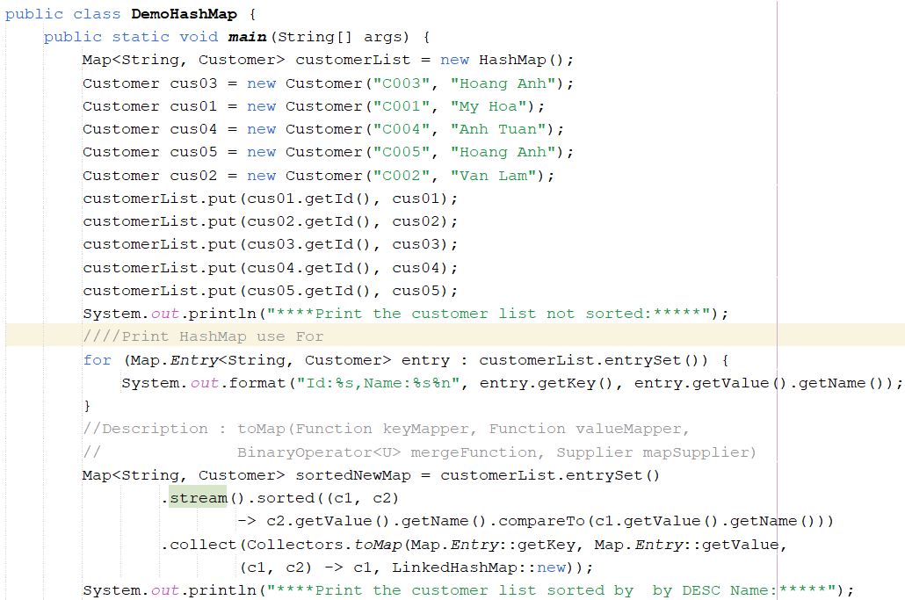
Demo HashMap 02

Slide 51
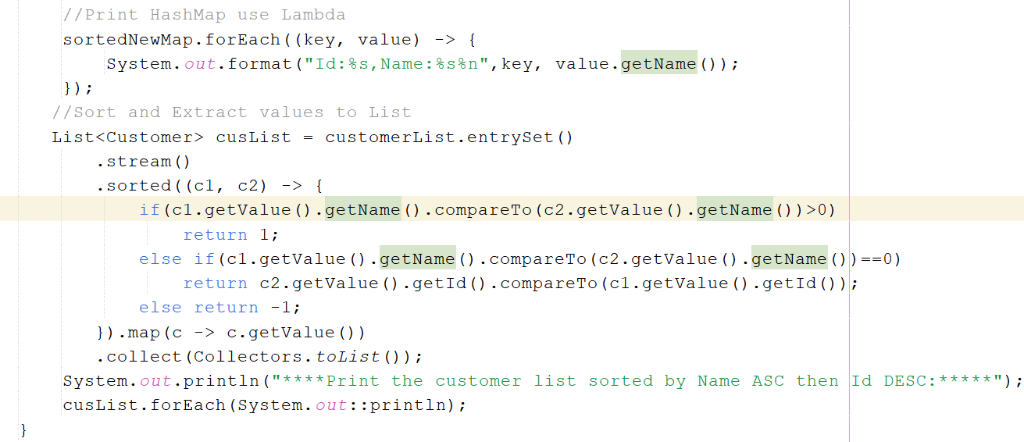
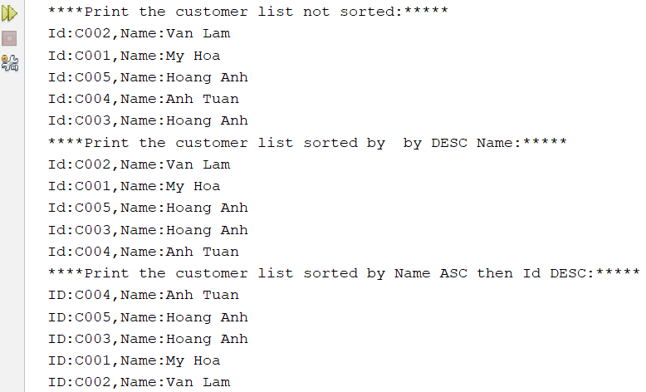

Slide 52
Summary
The Collections Framework
The Collection Super interface and Iteration
Lists
Sets
Maps

Slide 53

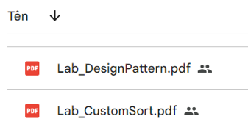
Practice

Slide 54
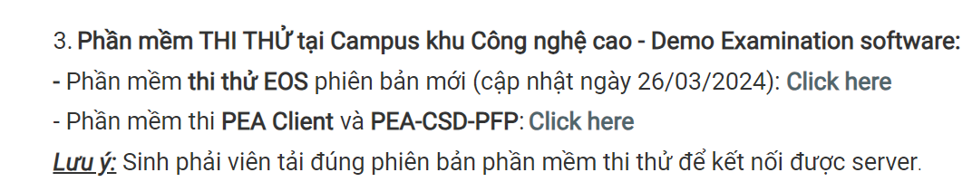
PE Try Exam-PRO192
Test Name: PE_PRO192_TrialExam_012345
Đọc hướng dẫn sử dụng HuongDanSuDung_Tool Practical Exam.pdf trên thư mục TaiLieuMonHoc (Google Drive)
Sinh viên kết nối wifi FPTU_Exam (luôn chọn Connect automatically). Mật khẩu: 12345678
Tải phần mềm thi mới nhất tại LMS: PEA Client Thi Thu
4. Nộp bài theo hướng dẫn trong đề thi.

